Slide 1
Recommender System for Workers
Group Members:
Mussawar Al Yasah (P14-6105)
Asad Fiaz (P14-6079)
Usama Hassan (P14-6090)
Supervised By:
Dr. Nouman Azam

Slide 2
Table of contents
Problem Statement
Motivation
Objectives & Scope
Workflow Diagram
Recommender System
Collaborative Filtering
Worker’s similarity Computation
Poster
Use Case Diagram
User Interface
References

Slide 3
Problem Statement
A web based application that will recommend the best worker on the basis of previous Experience, Projects and Ratings.

Slide 4
Motivation
Recommendation Systems are very useful to generate revenue because when user finds all the items of his own interest, he sticks to the website or whatever platform he uses that could use RS.
RS increases sales up to 35%.
E.g. Netflix prize

Slide 5
Objectives & Scope
Literature Review
suitable recommendation technique
Dataset Exploration
Achieving worker’s ratings from dataset
Preprocessing
Use of Recommendation generating algorithms
Analysis of different algorithms
Select best algorithm by comparing of all chosen algorithms
Web Based Application
Interface

Slide 6
Workflow Diagram
Literature Review
Data Scraping
Data Preprocessing
Collaborative Filtering Process
Integration
Final Product
Recommender Systems
Content Based Filtering
Collaborative Filtering
Knowledge Based Filtering
Data Extraction (Career Builder)
Feature Reduction
Reduce Sparsity
Recommendation
Web App
Similarity Calculation
Prediction

Slide 7
Recommender System
A recommender system is a subclass of information filtering system that seeks to predict the "rating" or "preference" that a user would give to an item. [1]
They use information filtering algorithms to generate personalized recommendations to support decision making of users.
https://en.wikipedia.org/wiki/Recommender_system

Slide 8
Recommender System
Collaborative filtering
A method of making predictions about the interests of a user by collecting preferences from different users.
If a user A has rated same as user B to worker I, A is more likely to have B's Preference to a different worker than that of a randomly chosen User.

Slide 9
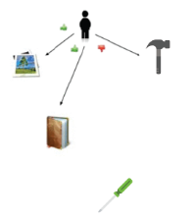
Collaborative Filtering
Basic assumption and idea
Users give ratings to workers(implicitly or explicitly)
Customers who had similar tastes in the past, will have similar tastes in the future

Slide 10
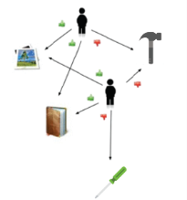
Collaborative Filtering
Basic assumption and idea
Users give ratings to workers(implicitly or explicitly)
Customers who had similar tastes in the past, will have similar tastes in the future

Slide 11
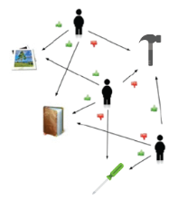
Collaborative Filtering
Basic assumption and idea
Users give ratings to workers(implicitly or explicitly)
Customers who had similar tastes in the past, will have similar tastes in the future

Slide 12
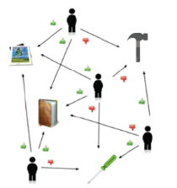
Collaborative Filtering
Basic assumption and idea
Users give ratings to workers(implicitly or explicitly)
Customers who had similar tastes in the past, will have similar tastes in the future

Slide 13
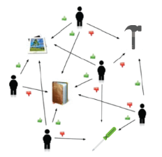
Collaborative Filtering
Basic assumption and idea
Users give ratings to workers(implicitly or explicitly)
Customers who had similar tastes in the past, will have similar tastes in the future

Slide 14
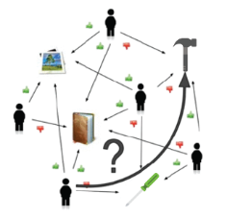
Collaborative Filtering
Basic assumption and idea
Users give ratings to workers(implicitly or explicitly)
Customers who had similar tastes in the past, will have similar tastes in the future

Slide 15
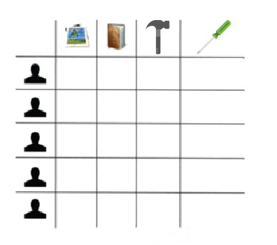
Collaborative Filtering
Basic assumption and idea
Users give ratings to workers(implicitly or explicitly)
Customers who had similar tastes in the past, will have similar tastes in the future

Slide 16
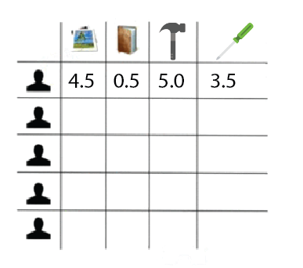
Collaborative Filtering
Basic assumption and idea
Users give ratings to workers(implicitly or explicitly)
Customers who had similar tastes in the past, will have similar tastes in the future

Slide 17
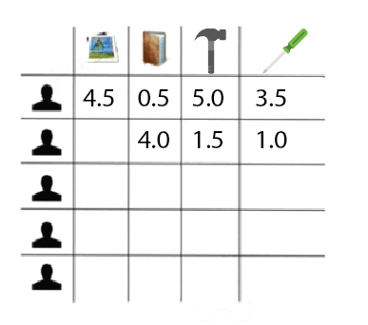
Collaborative Filtering
Basic assumption and idea
Users give ratings to workers(implicitly or explicitly)
Customers who had similar tastes in the past, will have similar tastes in the future

Slide 18
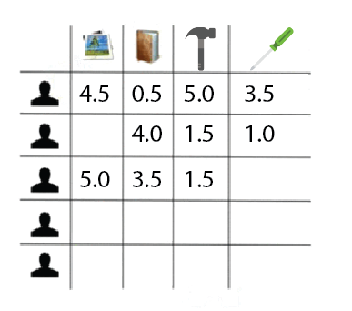
Collaborative Filtering
Basic assumption and idea
Users give ratings to workers(implicitly or explicitly)
Customers who had similar tastes in the past, will have similar tastes in the future

Slide 19
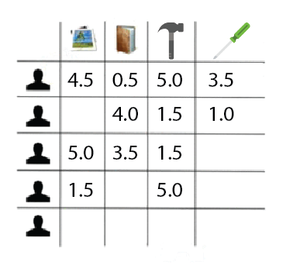
Collaborative Filtering
Basic assumption and idea
Users give ratings to workers(implicitly or explicitly)
Customers who had similar tastes in the past, will have similar tastes in the future

Slide 20
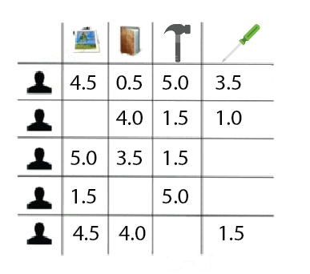
Collaborative Filtering
Basic assumption and idea
Users give ratings to workers(implicitly or explicitly)
Customers who had similar tastes in the past, will have similar tastes in the future

Slide 21
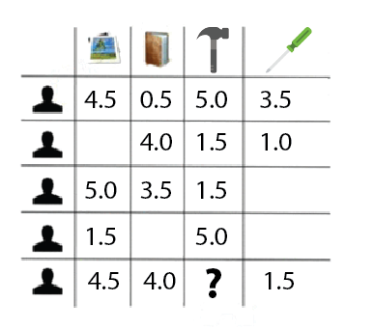
Collaborative Filtering
Basic assumption and idea
Users give ratings to workers(implicitly or explicitly)
Customers who had similar tastes in the past, will have similar tastes in the future

Slide 22
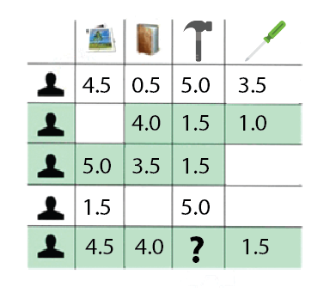
Collaborative Filtering
Basic assumption and idea
Users give ratings to workers(implicitly or explicitly)
Customers who had similar tastes in the past, will have similar tastes in the future

Slide 23
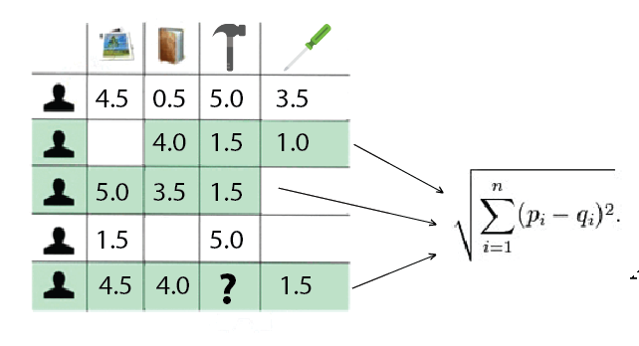
Collaborative Filtering
Basic assumption and idea
Users give ratings to workers(implicitly or explicitly)
Customers who had similar tastes in the past, will have similar tastes in the future

Slide 24
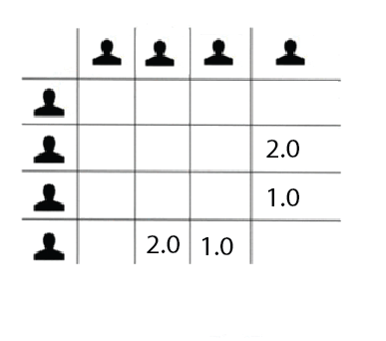
Collaborative Filtering
Basic assumption and idea
Users give ratings to workers(implicitly or explicitly)
Customers who had similar tastes in the past, will have similar tastes in the future

Slide 25
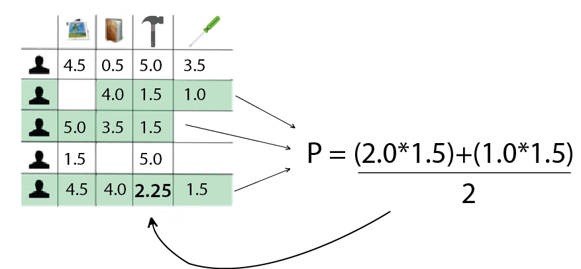
Collaborative Filtering
Basic assumption and idea
Users give ratings to workers(implicitly or explicitly)
Customers who had similar tastes in the past, will have similar tastes in the future

Slide 26

Collaborative Filtering
Basic assumption and idea
Users give ratings to workers(implicitly or explicitly)
Customers who had similar tastes in the past, will have similar tastes in the future

Slide 27
Collaborative Filtering Process
Similarity Measures:
We can compute similarities among the workers by using different methods.
Prediction:
By using different similarity measures, the model can make predictions.
Recommendation:
A list of N workers, the active user will like the most.
After getting similarity measurements, top k workers can be selected to recommend the user.

Slide 28
Types of Collaborative Filtering
Memory based
Cosine Similarity
Correlation Similarity
Adjusted Cosine Similarity
Jaccard’s Similarity
Euclidean Distance similarity
Model based
SVD (Singular Value Decomposition) Netflix prize winner

Slide 29
Worker Similarity Computation
Similarity between worker i & j are computed by isolating the users who have rated them and then applying a similarity computation technique.

Slide 30

Cosine-based Similarity
Workers are vectors in the m dimensional user space (difference in rating scale between users is not taken into account).

Slide 31
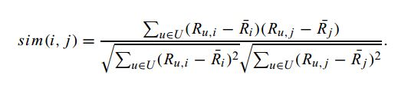
Correlation-based Similarity
Using the Pearson-r correlation (used only in cases where the uses rated both worker i & worker j).
R(u,i) = rating of user u on worker i.
R(i) = average rating of the i-th worker.

Slide 32

Adjusted Cosine Similarity
Each pair in the co-rated set corresponds to a different user. (takes care of difference in rating scale).
Here Ru is the average of the u-th user’s rating

Slide 33


Other Similarity Measures
Jaccard Coefficient
Euclidean Distance

Slide 34
Model Based Technique
Singular Value Decomposition (SVD)
U = user, W = worker, K = no. of latent features
For each sparse matrix M, there exist two small matrices with k latent features.
 | W1 | W2 | W3 | W4
U1
U2
U3
U4
 | K | K
U1
U2
U3
U4
 | W1 | W2 | W3 | W4
K
K

Slide 35

Evaluation Metrics
MAE(Mean Absolute Error)
It is one of the predictive accuracy metrics. It measures ratings of the user to what magnitude the system can expect. It computes the average of the absolute difference between the true ratings and predicted ratings.
Rating scale is 0 - 5.
N is the total no of ratings given by all users. Pi,j is the predicted rating for user I and worker j. Ri,j is the actual rating.

Slide 36

Evaluation Metrics
RMSE(Root Mean Squared Error)
It amplifies the contribution of absolute errors between the true values and predicted ratings.
Rating scale is 0 - 5.
N is the total no of ratings given by all users. Pi,j is the predicted rating for user I and worker j. Ri,j is the actual rating.

Slide 41

$$NRMSE=\frac{RMSE}{(Ymax−Ymin)}$$

Slide 42
Data Sparsity
Only 1% of the values are given and rest of 99% values are being predicted.
To reduce this issue, we are using extraction queries that specifies the profession and the location of the worker.
Size of user rating matrix decreases when we apply interface based

Slide 58
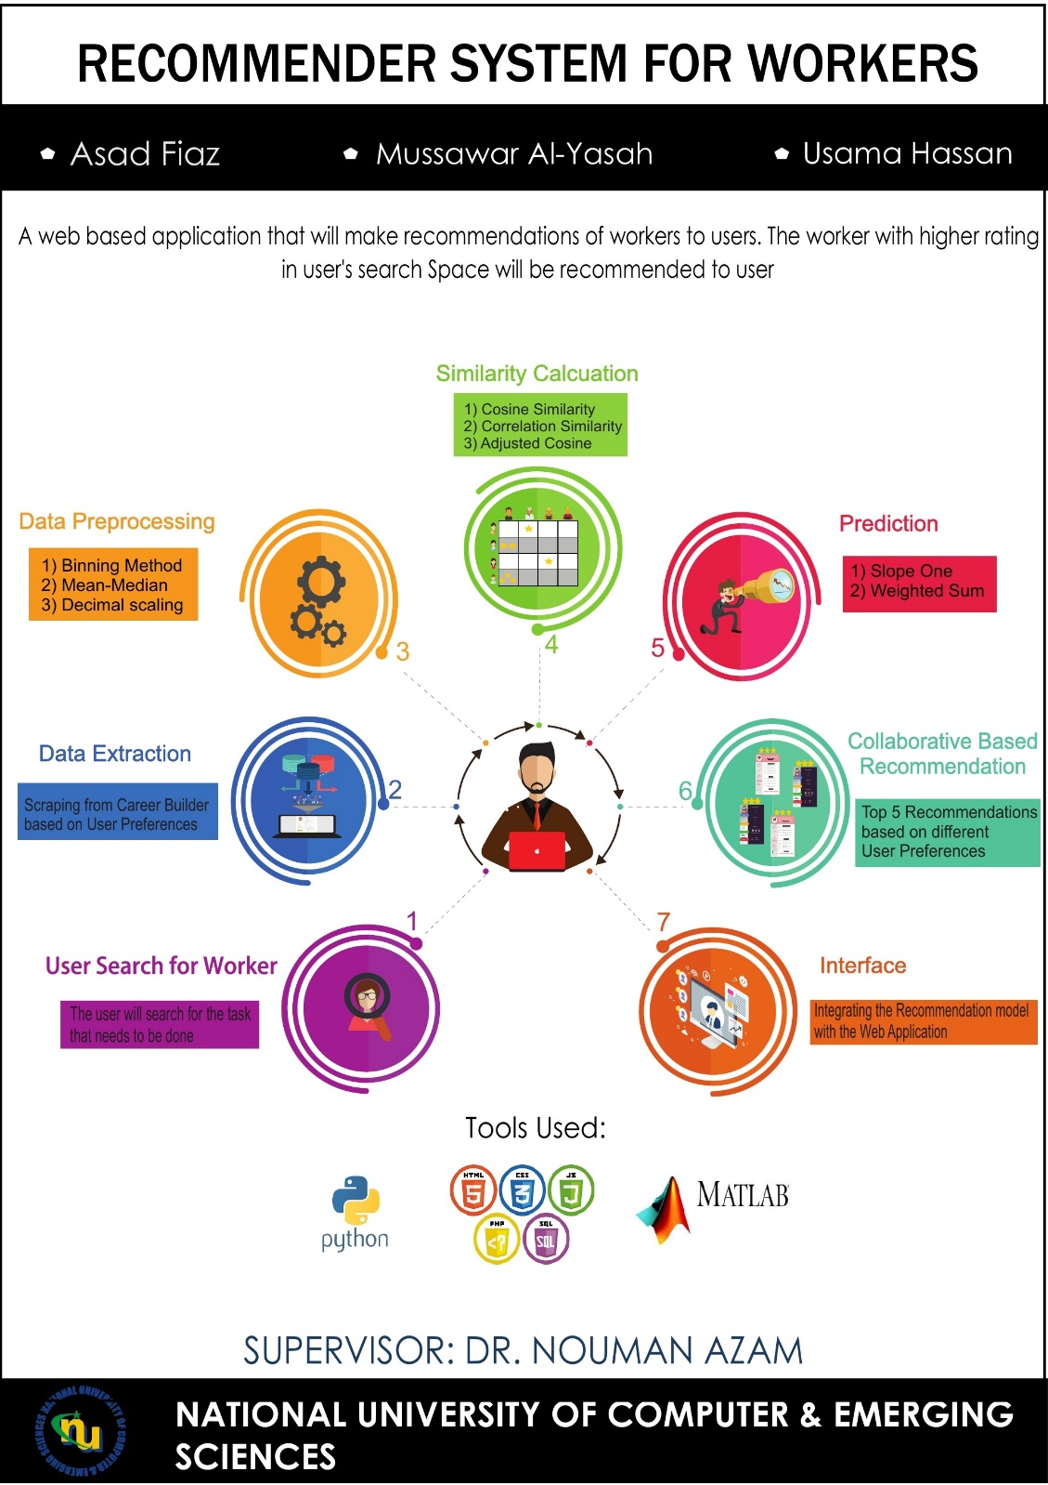
Poster

Slide 59
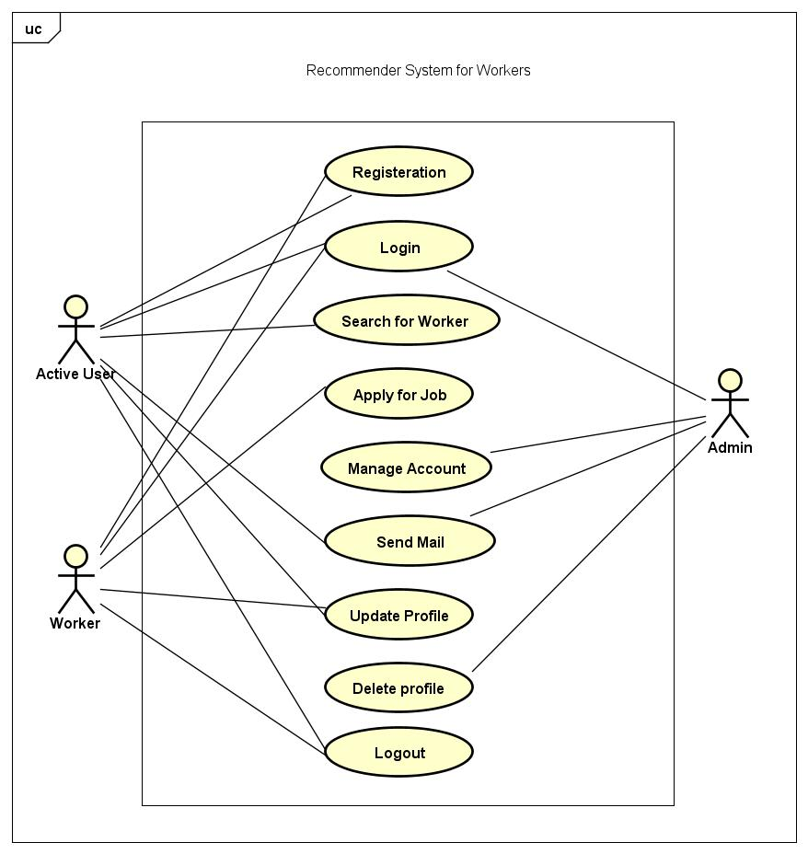
Use Case Diagram

Slide 60
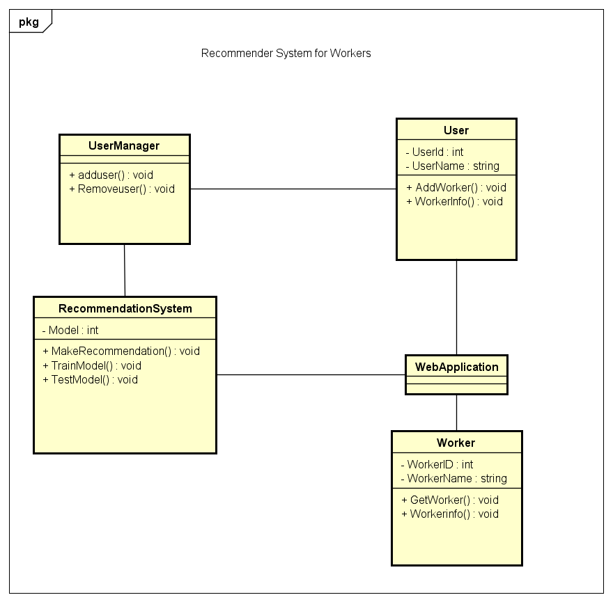
Class Diagram

Slide 61
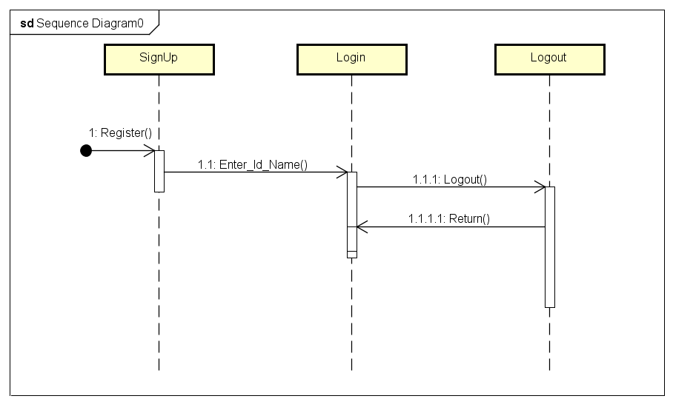
Sequence Diagram-I

Slide 62
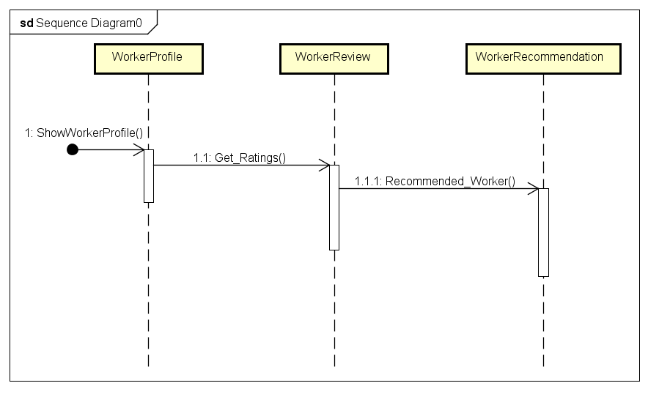
Sequence Diagram-II

Slide 63
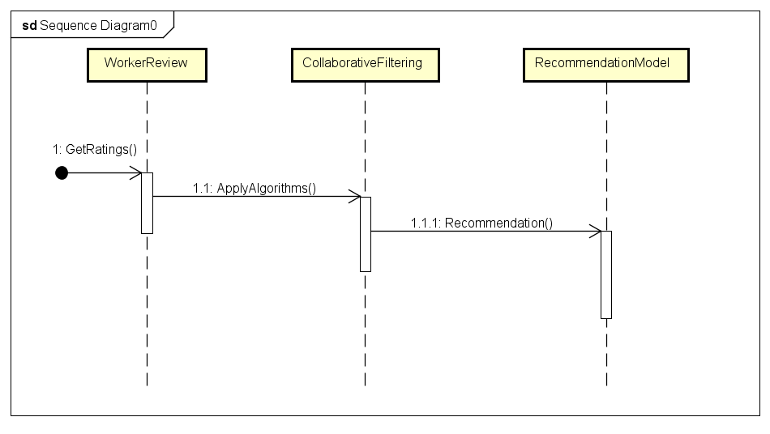
Sequence Diagram-III

Slide 64
Tools & Fields
Python/Flask
Matlab
JavaScript, Bootstrap, Ajax

Slide 65
Conclusions
Knn works very slow because it is memory based.
On the other hand matrix factorization methods are faster as they are model based. They only take time while training.
When the user-item matrix is small and less sparse, predictions and recommendation is very easy but it is very hard to get recommendations from sparsed dataset.

Slide 66
References
https://en.wikipedia.org/wiki/Recommender_system
Francesco Ricci and Lior Rokach and Bracha Shapira, Introduction to Recommender Systems Handbook, Recommender Systems Handbook, Springer, 2011, pp. 1-35
Xiaoyuan Su, Taghi M. Khoshgoftaar, A survey of collaborative filtering techniques, Advances in Artificial Intelligence archive, 2009.
"Robust collaborative filtering". Portal.acm.org. 19 October 2007. doi:10.1145/1297231.1297240. Retrieved 2012-05-15.
Elahi, Mehdi; Ricci, Francesco; Rubens, Neil. Active Learning in Collaborative Filtering Recommender Systems. Springer International Publishing. pp. 113–124. ISBN 978-3-319-10491-1.
Badrul Sarwar, George Karypis, Joseph Konstan, and John Riedl . Item-based Collaborative Filtering Recommendation Algorithms
https://en.wikipedia.org/wiki/Cosine_similarity
http://www.cs.tau.ac.il/~fiat/dmsem03/ItemBasedCollaborativeFilteringRecommendationAlgorithms

Slide 67
Thank You
Any Questions?

